Slide 1

Hotel Aggregator Analysis
By Madhavi

Slide 2
Table of Contents
Overview
Introduction
Geographical Insights
Pricing s Availability and Host Performance
Review Scores and Guest Satisfaction
Recommendations

Slide 3
Overview
This internship project aims to analyse a dataset of hotel aggregator listings using Power BI. The dataset comprises various attributes related to listings, hosts, reviews, and availability. The objective is to create comprehensive visualizations and insights that shed light on trends, patterns, and factors influencing the performance of listings. Through Power BI, interns will explore key metrics such as pricing, availability,
host characteristics, and review scores to derive
actionable insights for improving the overall quality and competitiveness of the listings.

Slide 4

Introduction
Interactive Power BI dashboards illustrating geographical distribution, pricing trends, host characteristics, and review scores.
Reports on availability patterns, property and room preferences, and factors influencing guest satisfaction.
Recommendations for hosts and the aggregator platform based on the analysis.

Slide 5
01
Geographical Insights

Slide 6
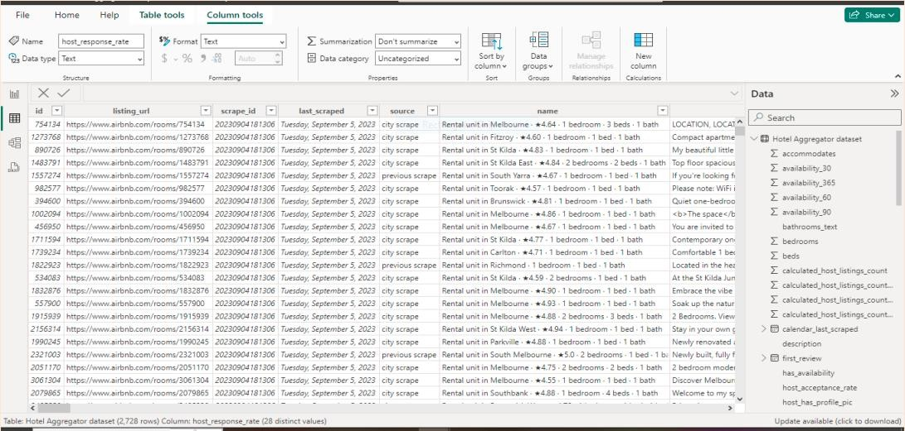



Import Data in Powerbi

Slide 7
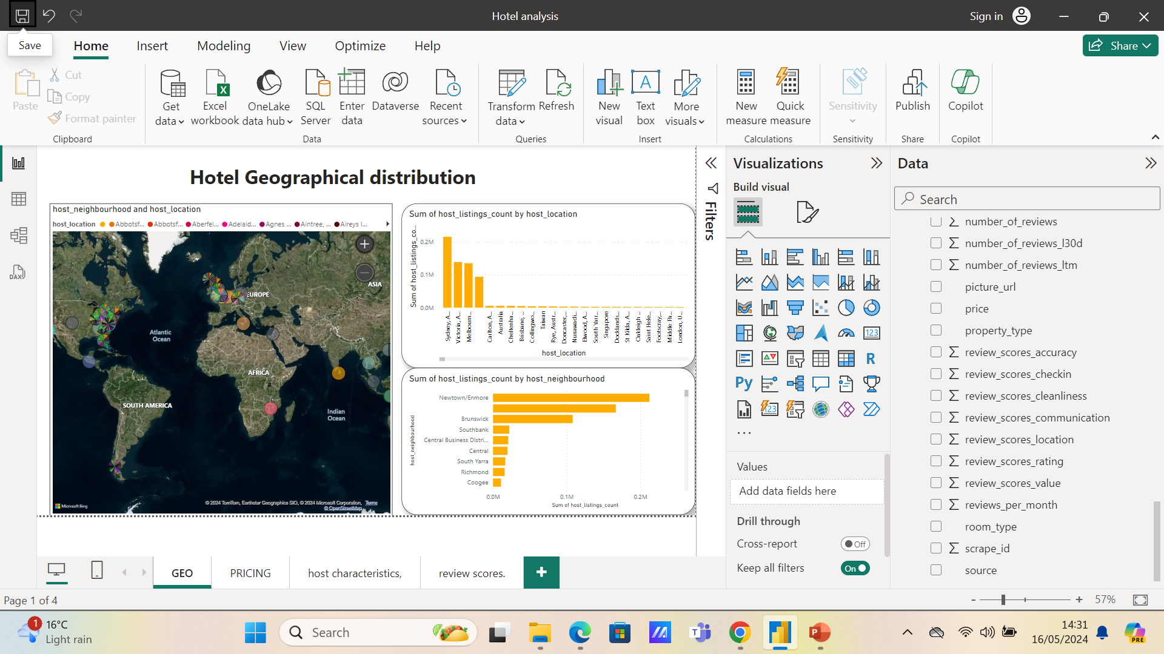

Slide 8
02
Pricings Availability

Slide 9
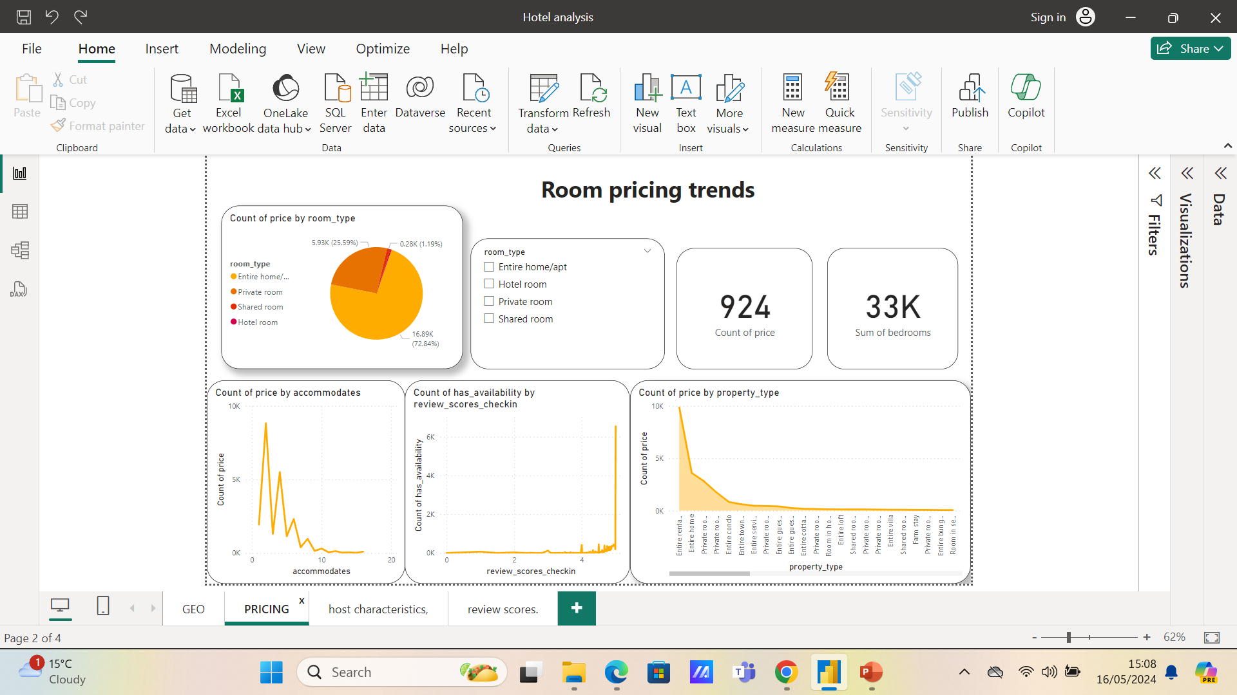

Slide 10
03
Host Performance

Slide 11
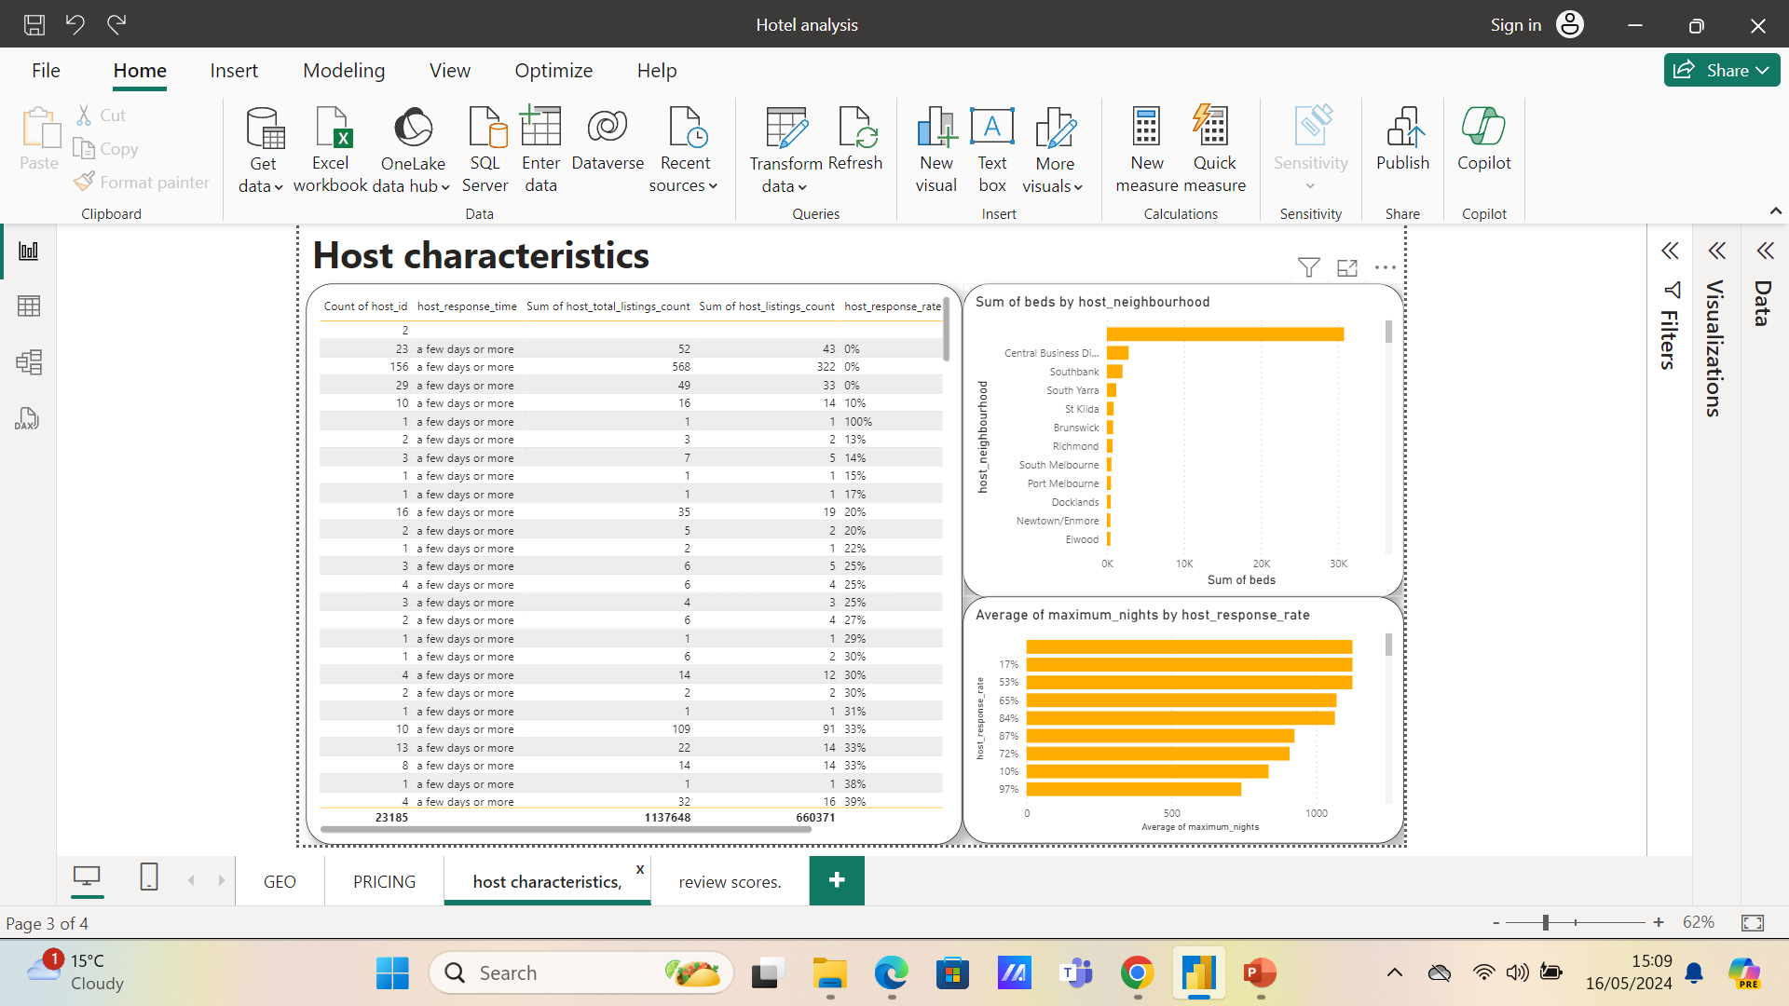

Slide 12
04
Review Scores and Guest Satisfaction

Slide 13
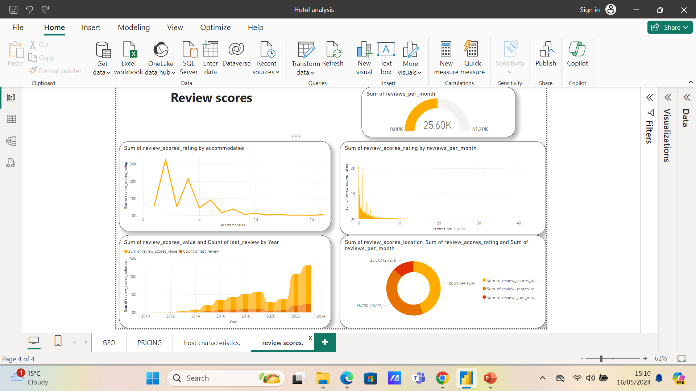

Slide 14
Recommendations
Ensuring that guests’ expectations match their experiences can lead tohigher review scores and more bookings.
Optimizing availability based on demand can help maximize bookings and revenue.
Consider the lowest review ratings in communication and locations, then the factors behind this low ratings. Improve communication as one low rating can highly affect other ratings, like location.
Note why some property or room types have high average total listings compared to others and find the common factors involving these types to improve.

Slide 15

A picture is worth a thousand words

Slide 16

Data shows that entire homes/apartments are generally more expensive than private rooms and hotel rooms. Offering more entire homes/apartments, if feasible, could increase revenue.

Slide 17
—Someone Famous
“This is a quote. Words full of wisdom that someone important said and can make the reader get inspired.”

Slide 18

Consider seasonality in pricing and availability strategy. Prices might be higher
during peak tourist seasons and lower during off-peak times.

Slide 19

Thanks!

